Slide 1
安全威胁情报体系的建设与应用

Slide 2
什么是安全威胁情报

Slide 3
当前信息安全防护体系面临困境
难以从海量的安全事件发现真正的攻击行为，IDS、SOC等传统安全产品使用效率低下
应用安全威胁情报技术
建设安全威胁情报平台
某一点确认的安全事件不能及时在组织内及时有效地进行共享，组织内部难以有效协同
不同类型、不同厂商的安全设备之间的漏洞、威胁信息不通用，不利于大型网络的维护管理
斯诺登等事件揭示的NSA对我国的攻击手段，目前的手段难以有效识别发现，亟需对现有安全体系进行升级

Slide 4
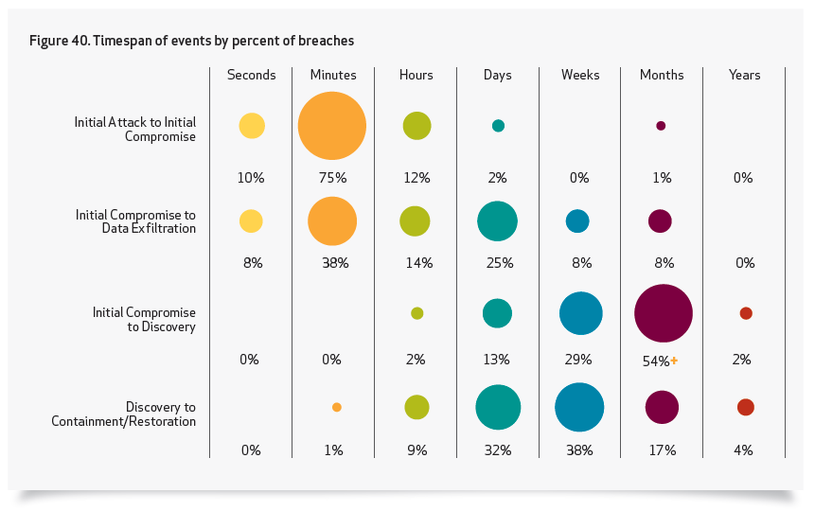
攻防速度之争！
Notes:
99% of breaches led to compromise within “days” or less with 85% leading to data exfiltration in the same time
85% of breaches took “weeks” or more to discover
84% of data records were stolen as a result of stolen login credential

Slide 5
速度！速度！还是速度！
Attacker
Surveillance
Attack
Begins
Attack
Set-up
Target
Analysis
Discovery/ Persistence
Leap Frog Attacks
Complete
Access
Probe
System
Intrusion
Cover-up
Starts
Cover-up
Complete
Maintain foothold
TIME
ATTACKER FREE TIME
Need to collapse free time
TIME
Physical Security
Monitoring & Controls
Containment & Eradication
Impact Analysis
Response
Threat Analysis
Attack
Forecast
Incident
Reporting
Recovery
System Reaction
Defender
Discovery
Attack
Identified
Damage Identification
Source: NERC HILF Report, June 2010 (http://www.nerc.com/files/HILF.pdf)

Slide 6

安全威胁情报是？
一些“热”词：
Security Intelligence 安全，安全情报
Threat Intelligence 威胁情报
Security Threat Intelligence 安全威胁情报
Cyber Threat Information Sharing 网络威胁信息共享
Intelligence Aware 情报感知
Intelligence Driven 情报驱动
Intelligence-Aware Security Control 基于情报感知的安全控制
Context Aware 情境感知
信誉库

Slide 7
企业外部的安全威胁情报源（含开源及商业）
OSINT
Dell SecureWorks
RSA NetWitness Live/Verisign iDefense
Symantec Deepsight
McAfee Threat Intelligence
SANS
CVEs, CWEs, OSVDB (Vulns)
iSight Partners
ThreatStream
OpenDNS
MAPP
IBM QRadar
Palo Alto Wildfire
Crowdstrike
AlienVault OTX
RecordedFuture
Team Cymru
ISACs / US-CERT
FireEye/Mandiant
Vorstack
CyberUnited
Norse IPViking/Darklist
Notes:
OSINT 中情局 公开资源情报计划 Open source intelligence

Slide 8
企业内部的安全威胁情报源（提供安全情境）
Directory user information (personal e-mail, access, user privilege, start/end date)
Proxy information (content)
DLP & business unit risk(trade secrets / IP sensitive docs)
IT Case history / ticket tracking
Malware detection / AV alerts
Sensitive business roles
Application usage & consumption events (in-house)
Database usage / access monitoring (privileged)
Entitlements / access outliers (in- house)
User behavior association based on geography, frequency, uniqueness, and privilege

Slide 9
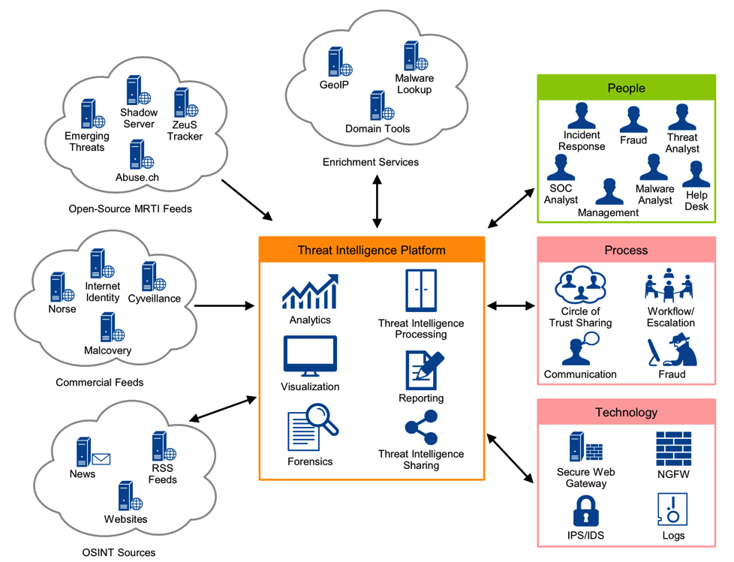
情报平台Threat intelligence platforms（TIPS）
预计至2018，50%的一线组织和MSSPs将会使用以MRTI为基础的TIP平台（目前不到5%）

Slide 10
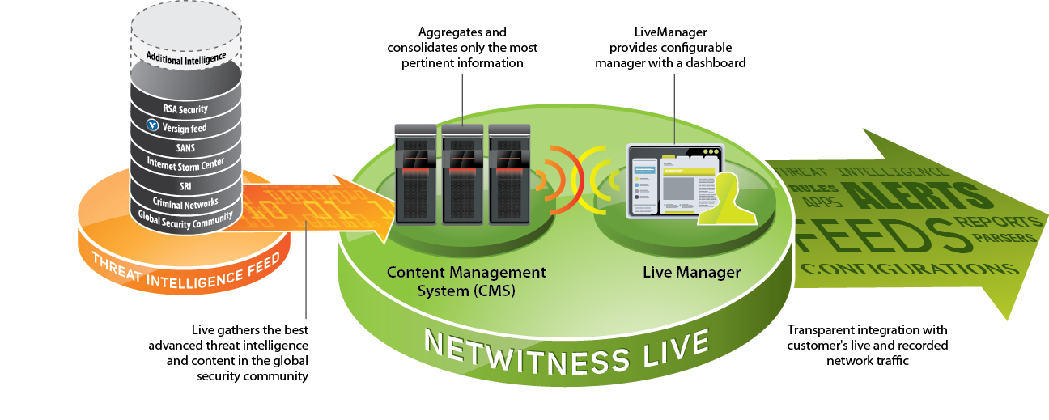
安全威胁情报应用示例之RSA NetWitness Live
Aggregates & consolidates only the most pertinent information
Live Manager provides configurable manager with a dashboard
Live gathers the best advanced threat intelligence and content in the global security community
Transparent integration with customer’s live and recorded network traffic

Slide 11
安全威胁情报应用示例之RSA NetWitness Live
RSA Fraudaction Domains
RSA Fraudaction IP
NW APT Attachments
NW APT IP
NW APT Domains
NW Suspicious IP Intel
NW Criminal VPN Entry Domains
NW Criminal VPN Entry IP
NW Criminal VPN Exit IP
NW Criminal VPN Exit Domains
NW Criminal SOCKS nodes
NW Criminal SOCKS User IP’s
NW Insider Threat Domains
NW Insider Threat IP
APT Filenames
Palevo Tracker IP
Palevo Tracker Domains
QakBot C2 Domains
Critical Intelligence Domains - SCADA
Critical Intelligence IP’s - SCADA
Dynamic DNS Domains
TOR Exit Nodes
TOR Nodes
eFax sites (data leakage)
iDefense Threat Indicators
ISEC Exposure Blacklist Domains

Slide 12
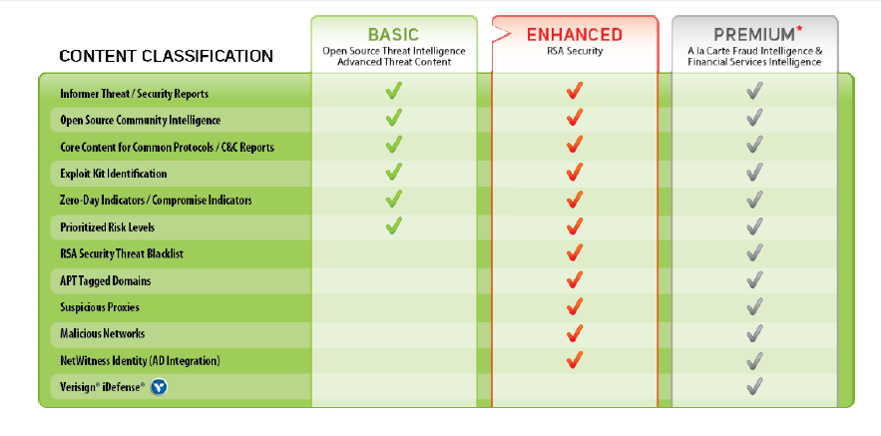
安全威胁情报应用示例之RSA NetWitness Live

Slide 13
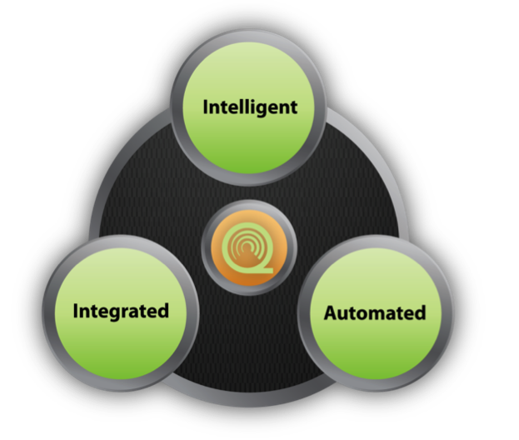
安全威胁情报应用示例之IBM Qradar SIP
Proactive threat management
Identifies critical anomalies
Rapid, extensive impact analysis
Bridges silos
Highly scalable
Flexible & adaptable
Easy deployment
Rapid time to value
Operational efficiency

Slide 14














安全威胁情报应用示例之IBM QRadar SIP
Context and Correlation Drive Deepest Insight
Security Devices
Servers & Mainframes
Event Correlation
Network & Virtual Activity
Logs
Flows
IP Reputation
Geo Location
Database Activity
Offense Identification
Activity Baselining & Anomaly Detection
Credibility
Severity
Relevance
Application Activity
User Activity
Database Activity
Application Activity
Network Activity
Configuration Info
Vulnerability Info
Users & Identities
Suspected Incidents
Extensive Data Sources
Deep Intelligence
Exceptionally Accurate and Actionable Insight
+
=

Slide 15









安全威胁情报应用示例之IBM QRadar SIP
Fully Integrated Security Intelligence
Log Management
Turnkey log management
SME to Enterprise
Upgradeable to enterprise SIEM
SIEM
Integrated log, threat, risk & compliance mgmt.
Sophisticated event analytics
Asset profiling and flow analytics
Offense management and workflow
Risk & Configuration Management
Predictive threat modeling & simulation
Scalable configuration monitoring and audit
Advanced threat visualization and impact analysis
Network Activity & Anomaly Detection
Network analytics
Behavioral anomaly detection
Fully integrated with SIEM
Network and Application Visibility
Layer 7 application monitoring
Content capture for deep insight
Physical and virtual environments

Slide 16
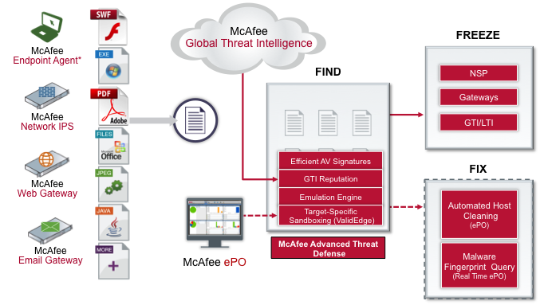
安全威胁情报应用示例之McAfee Threat Intelligence

Slide 17
安全威胁情报体系的建设

Slide 18
标准是最好的建设参考
STIX - Structured Threat Information eXpression
TAXII - Trusted Automated eXchange of Indicator Information
CybOX - Cyber Observable eXpression
MAEC - Malware Attribute Enumeration and Characterization
OpenIOC - Open sourced schema from Mandiant
IODEF - Incident Object Description Exchange Format
CIF - Collective Intelligence Framework
IDXWG - Incident Data eXchange Working Group
Notes:
Cybox 从管理监控属性角度描述事件，如注册表创建，文件删除，访问某个端口
Maec 从攻击，行为模式描述恶意代码的语言
Structured Threat Information eXpression (STIX) effort, which is driven by Mitre. STIX "is primarily intended as a concrete strawman for ongoing collaborative development of a structured threat information expression language among a community of relevant experts" (source: STIX FAQ v0.3). In other words, its goal is to enable people and organizations to share threat information in order to detect these threats and then build defenses collaboratively (see the Cyber Observable eXpression Web page for details).
Trusted Automated eXchange of Indicator Information (TAXII) effort, also by Mitre, that seeks to create "a set of protocols and representations that enable the representation and automation-supported sharing of behavioral cyber threat indicators" (source: STIX whitepaper). It is a companion effort to STIX.
OpenIOC, which is a vendor-developed standard for sharing the data that is useful for
discovering threats — known as "indicators of compromise" (IOCs)4 — that are already present on an organization's network. It "is an extensible XML schema for the description of technical characteristics that identify a known threat, an attacker's methodology, or other evidence of compromise" (see the OpenIOC website for details).
Incident Object Description Exchange Format (IODEF), which is an older effort that has been revived and extended to support structured cybersecurity information by a Managed Incident Lightweight Exchange (MILE) working group. The group seeks to "develop standards and extensions for the purpose of improving incident information sharing and handling capabilities" (source: http://www.ietf.org/proceedings/82/mile.html). The results of its work were published in 2012. As with other, related efforts, it also aims "to exchange enriched cybersecurity information among cybersecurity entities and facilitate their operations" (source: http:// tools.ietf.org/html/draft-ietf-mile-sci-05).
Collective Intelligence Framework (CIF), which was created by REN-ISAC, is in active use for data sharing across universities and members of REN-ISAC. The effort has resulted in a protocol (loosely based on IODEF) and a system for sharing (including automated usage of data in security devices) and is expanding to additional types of data.
Incident Data eXchange Working Group (IDXWG) team at US-CERT that is working on ways to share security incident data models, threat indicators and other relevant security data using existing and emerging standards.

Slide 19
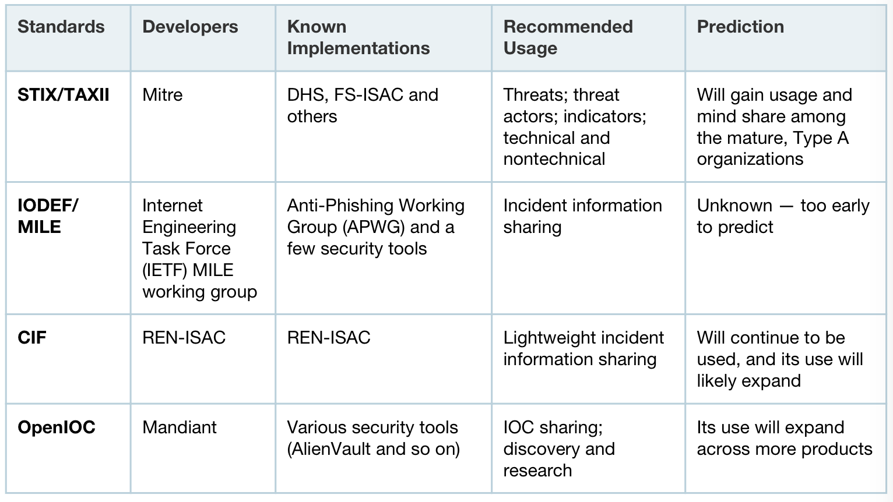
主要协议和标准比较
Notes:
马萨诸塞州理工学院研究会 美国政府自主的公益组织

Slide 20
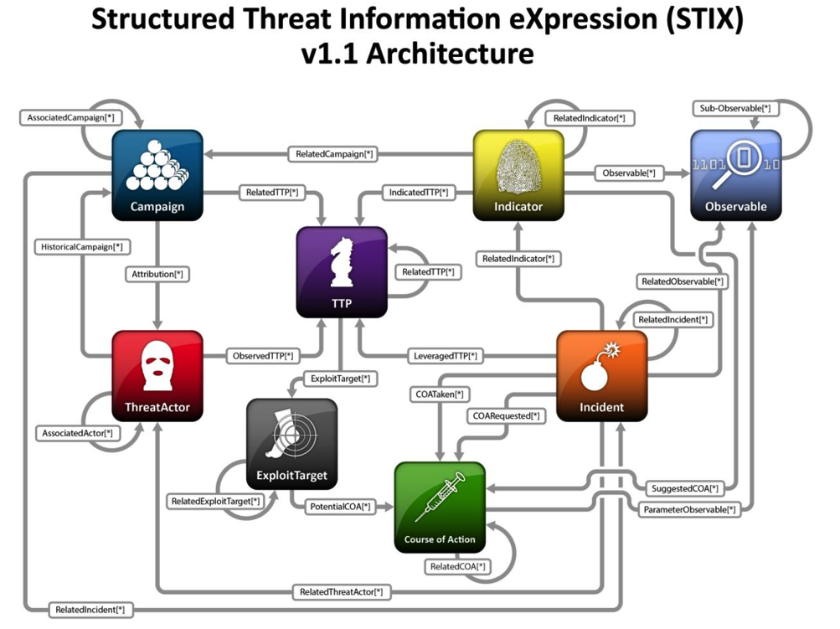
STIX标准要点浅析
Notes:
1、Obsverable：我们能够观察到的行为。是威胁情报中最基本的信息。比如网络堵塞、系统遭受到的破坏等等现象。这些都是日后事件处理的关键信息。
2、Indicators（威胁指标）：表征这个威胁的特征指标。也就是威胁外在表象的内在特征。通过查看这些特征可以判定是否真的遭受了这个威胁的攻击。包括威胁处理的条件, 可能的影响，有效时间, 建议的处理方法，检测或测试方法, 指标来源。
3、Incident（突发事件）：对事件的描述，包括时间、位置、影响、相关的指标、利用TTP，攻击意图，影响评估，响应行动的要求，采取的行动响应过程，事件的日志信息源等。下面是一个关于网络钓鱼事件描述主要包含的信息，直接引用原文。►Time ►Granular set of Incident lifecycle timestamps ►Description ►Roles (Reporter, Responder, Coordinator, Victim) ►Affected Assets ►Impact Assessment ►Related Indicators ►Leveraged TTP ►Related Threat Actors ►Intent ►Discovery Method ►Related Incidents ►COA Requested / COA Taken ►Confidence ►Contact ►History
4、TTP（Tactics, Techniques, and Procedures）：威胁情报中的关键信息。TTP 将安全事件全面进行了描述，并分手段、技术、过程三个维度分析，包括了恶意攻击的行为、采用了什么工具、受害目标、利用了什么弱点、影响及后果、kill chain 等等。
5、Campaign：攻击者的动机，为什么要发起这次攻击。下面是关于campaign的描述样例►Names ►Intent ►Related TTPs ►Related Incidents ►Related Indicators ►Attribution ►Associated Campaigns ►Confidence ►Activity ►Information Source
6、ExploitTarget：被攻击系统、以及被利用的系统漏洞等信息7、Course of Action：针对 ExploitTargets 所采取的行动，以降低 Incident 的影响范围。8、ThreatActor：威胁源，即攻击发起方是谁？

Slide 21
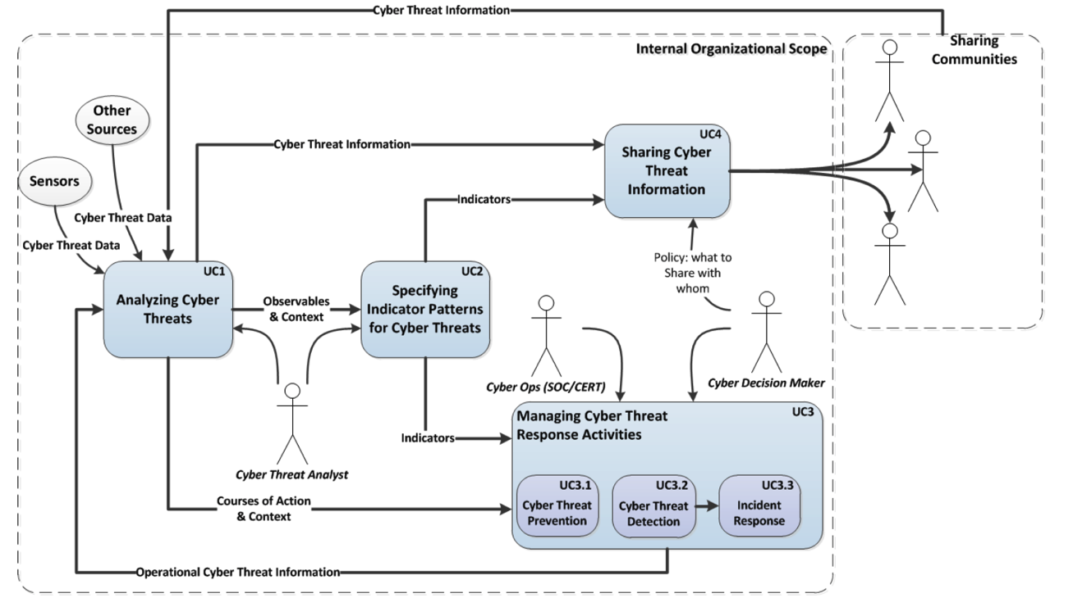
STIX标准要点浅析
Notes:
主要可适用在以下四类场景
1.威胁分析。威胁的判断、分析、调查、保留记录等使用。
2.威胁特征分类。将威胁特征进行分类，以人工方式或自动化工具。
3.威胁及安全事件应急处理：安全事件的防范、侦测、处理、总结等，在安全事件处置过程中可以有很好的借鉴，以前做事件处理没有这么详尽的信息。
4. 威胁情报分享。用标准化的框架进行描述与分享。

Slide 22
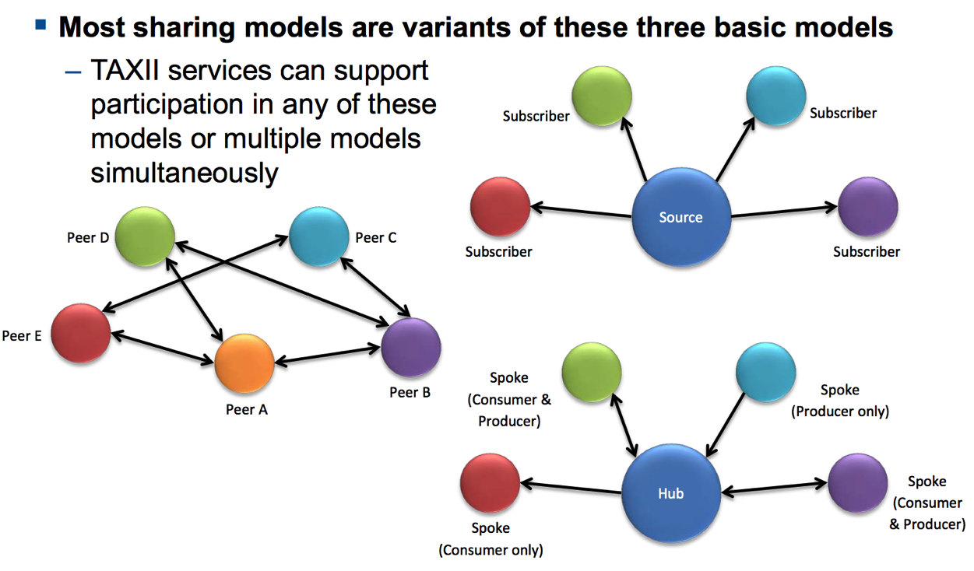
TAXII标准要点浅析
Notes:
点对点
订阅型
星型

Slide 23
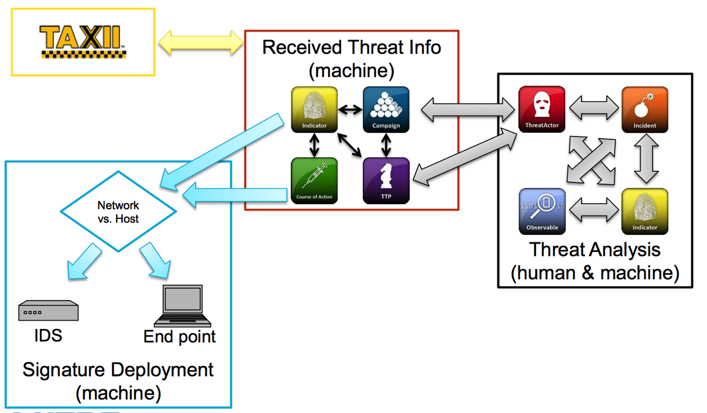
TAXII标准要点浅析
Notes:
发现、收集管理、推送、拉回

Slide 24
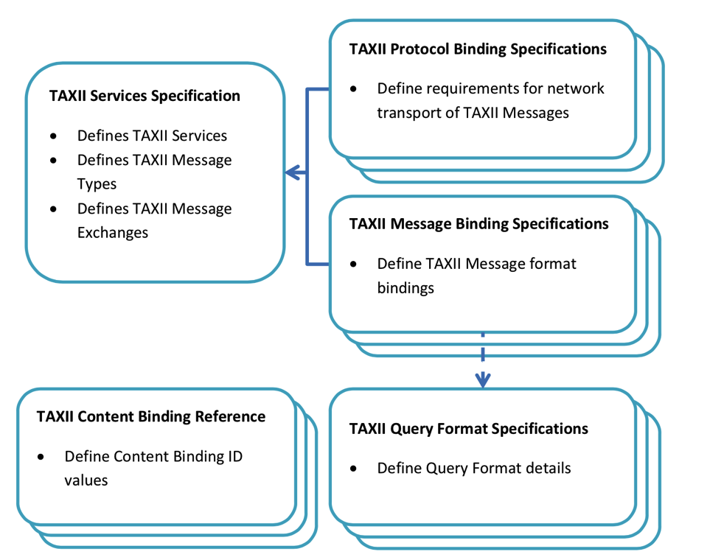
TAXII标准要点浅析
Notes:
服务规范：定义了TAXII的服务类型、TAXII情报类型以及情报交流格式
消息规范：采用XML格式
协议规范：确定了HTTP/HTTPS作为TAXII传送的协议。从安全角度考虑可采用https协议传输。查询格式规范：定义了缺省的查询格式和处理规则。
内容及参考样例：列举了常用的样例。

Slide 25
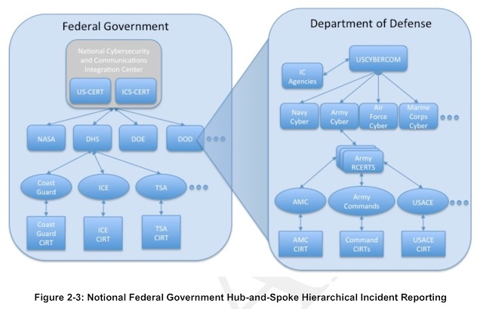
美国联邦政府标准NIST 800-150 Draft要点浅析

Slide 26
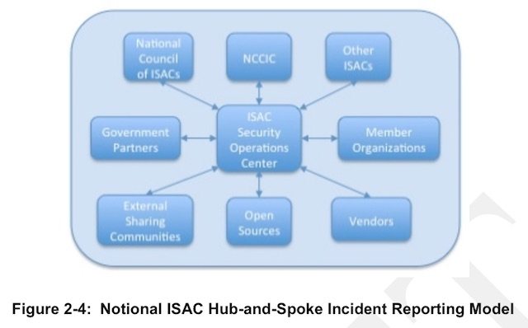
美国联邦政府标准NIST 800-150 Draft浅析

Slide 27
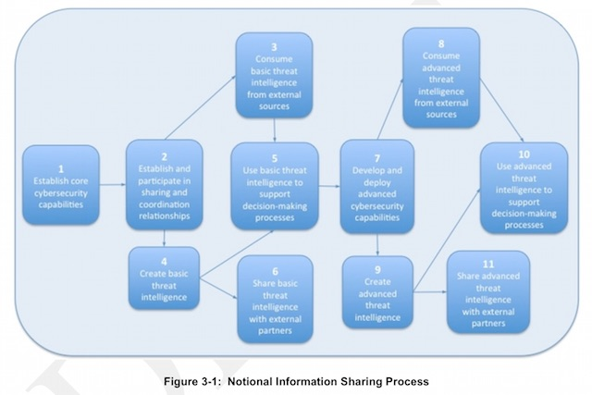
美国联邦政府标准NIST 800-150 Draft浅析
Notes:
1.建立核心网络安全能力
2.建立和参与分享协同关系
3.利用基础的外部威胁情报
4.建立基础的威胁情报
5.使用基础的威胁情报来支持决策过程
6.与外部伙伴共享基础信息源
7.建设和实施高级网络安全能力
8.使用外部高级威胁情报
9.建立自己的高级威胁情报
10.使用高级的威胁情报来支持决策过程
11.和外部伙伴共享高级情报external partners

Slide 28
美国联邦政府标准NIST 800-150 Draft浅析
典型共享信息内容：
IP addresses and domain names
URLs involved with attacks
Simple Mail Transport Protocol (SMTP) headers, email addresses, subject lines, and contents of emails used in phishing attacks
Malware samples and artifacts
Adversary Tactics, Techniques, and Procedures (and effectiveness)
Response and mitigation strategies
Exploit code
Intrusion signatures or patterns
Packet captures of attack traffic
NetFlow data
Malware analysis reports
Campaign/actor analyses
Disk and memory images

Slide 29
美国联邦政府标准NIST 800-150 Draft浅析
共享过程中需要注意隐私问题
URL、域名、IP、文件名等信息不能暴露被攻击者
捕获的报文不能包含登陆凭据、财务信息、健康信息、案件信息及web表单提交数据等
钓鱼文件样本不能包括任何与事件响应人员无关的敏感信息
Web/代理日志中不能包含如登陆凭据、URL参数中的ID数字等个人或业务行为
网络流量/NetFlow信息不能暴露员工行为或企业中与调查无关的内容（如访问了医疗情况相关的网站）
恶意代码样本，内容里面不能包括用户业务或个人相关信息
信息的敏感性也至关重要，需要遵从谅解备忘录MOUs、保密协议NDAs或其他协议框架，同时也需要遵从PII、SOX、PCI DSS、HIPPA、FISMA、GLBA等法律法规。
同时也必须对交换的信息进行标识，约定其使用范围。

Slide 30
我的TIPS理想架构
上级智能威胁信息交换平台
外部智能威胁信息交换源
威胁情报
上报
威胁情报
获取
威胁情报
共享
威胁情报
获取
智能威胁信息交换平台
APT分析
事件管理
日志关联分析
查询搜索
验证
威胁情报管理
响应管理
待分析威胁数据
威胁数据feed
威胁情报
上报
威胁情报
获取
检测、网关类设备
分析平台
防火墙
防病毒网关
SIEM
网管
IDS/ IPS
客户端防病毒
Anti-APT
SDN&DPI

Slide 31
安全威胁情报体系的应用

Slide 32
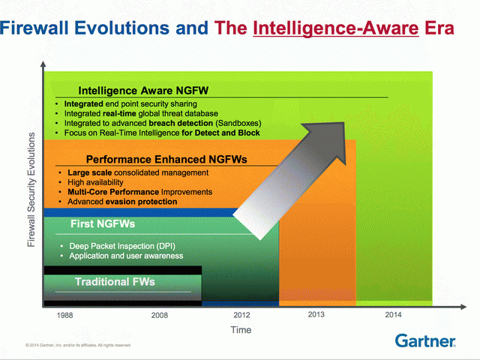
NG的NG？

Slide 33
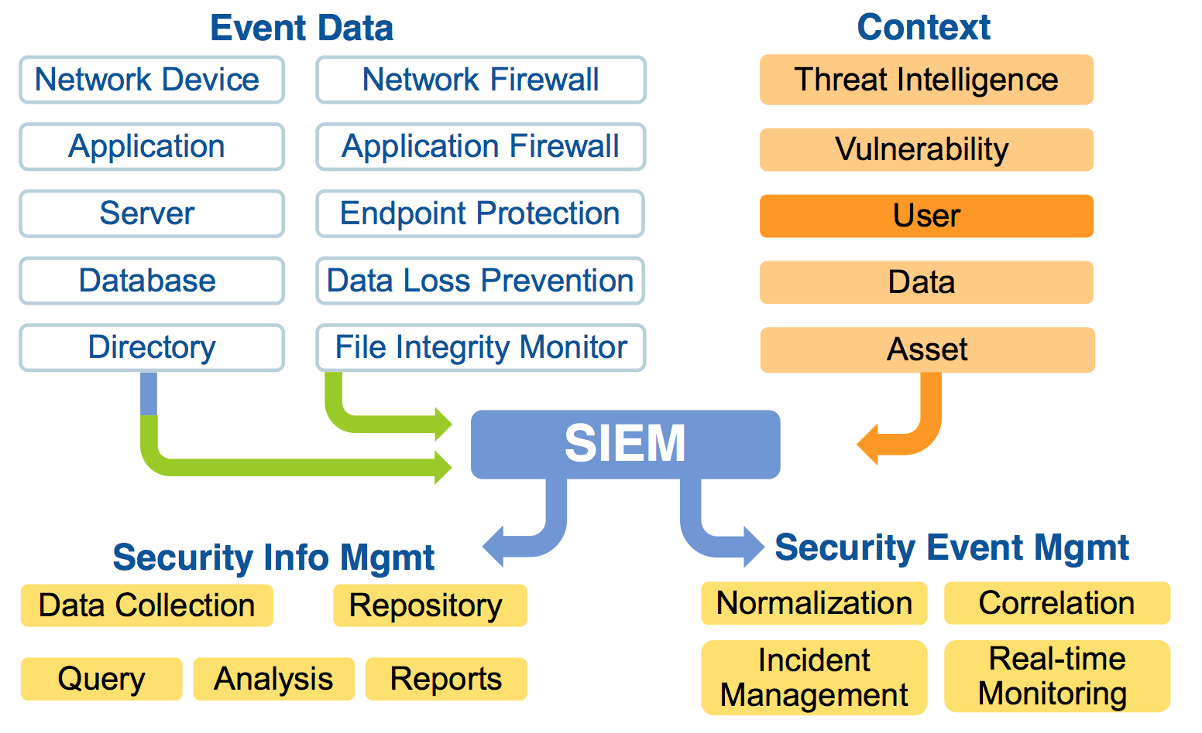
情境/情报感知？
Notes:
情境：
Who，低信誉的用户（比如已经中毒的用户，发现存在攻击行为的用户）
What，来自IT不支持的Linux 客户端的访问（客户端都是Win 7，突然来了个Linux来访问自然不正常）
To What，对敏感数据的访问（是否访问的是敏感数据）
When，周日凌晨的访问（这明显不是工作时间，访问也明显异常）
Where，来自没有业务的海外（这也很明显异常）

Slide 34
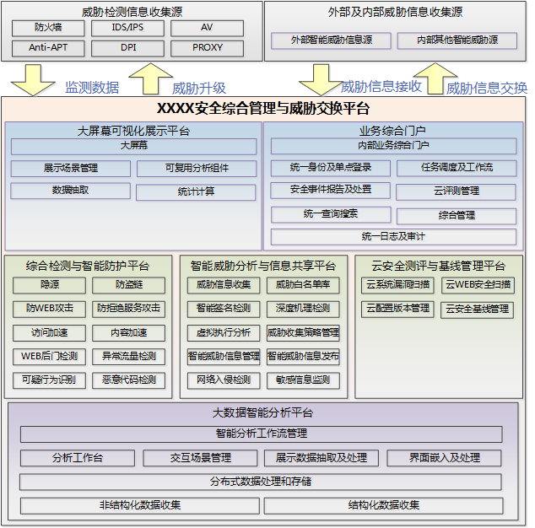
以SECaaS模式为核心的网络安全情报中心

Slide 35
安全威胁情报的发展方向
人读
机读
简单
丰富
非实时
实时
孤立
共享

Slide 36
对于企业应用实践的建议
应用结构化的 indicators of compromise（IOC ）
参考STIX定义安全威胁情报元模型，并对关键指标进行标准化
内部、外部可共享的IOCs
情报数据尽量多样化，不应仅是信誉库
应用威胁情报开展情境分析
SOC等分析型优先，逐步推动防护设备支持
自动化共享和分析处置
Notes:
攻击指示器

Slide 37


NUKE同学的手抄报
也可以关注网站
www.sec-un.org/author/nuke
讨论！

